Slide 1

Introduction

Slide 2
What is Machine Learning

Slide 3
Week goals
What does machine learning do?
What types of problems does it solve and what are real-world examples of such problems?
Describe main definitions

Slide 4
Machine Learning is Everywhere
Recommendations
Advertisement
Voice assistants
Self-driving cars
netflix.com
spotify.com
Ads.google.com
https://dribbble.com/shots/3115808-Virtual-Assistants
waymo.com
https://www.logodesignlove.com/tesla-logo

Slide 5

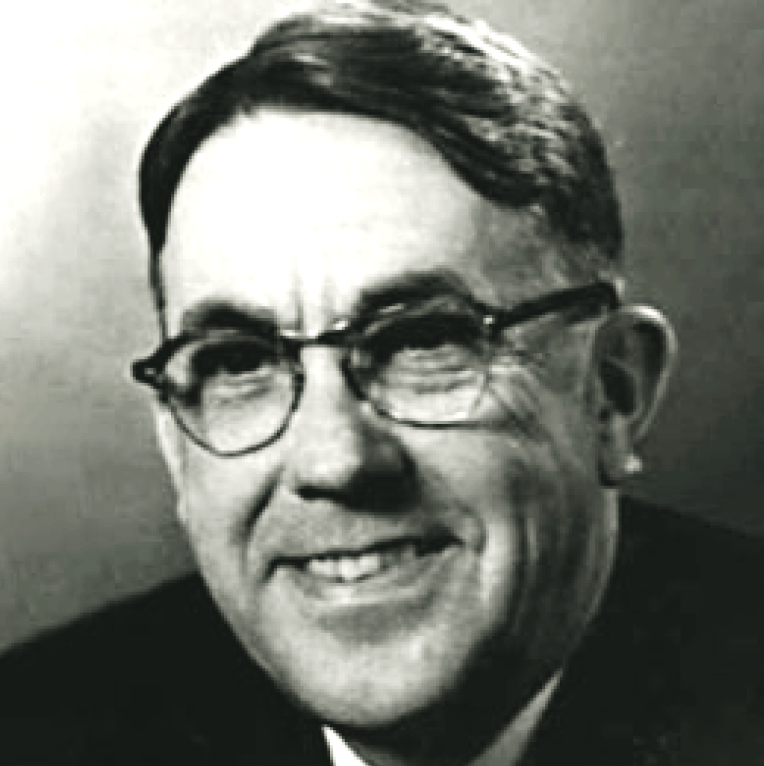
Machine Learning
Field of study that gives computers the ability to learn without being explicitly programmed
Arthur Samuel
en.wikipedia.org
Notes:
Arthur Samuel was computer scientists. He wrote the first self-learning program, which played checkers.

Slide 6
Machine Learning
Field of study that gives computers the ability to learn without being explicitly programmed
Arthur Samuel
What can we program explicitly?
en.wikipedia.org
Notes:
Arthur Samuel was computer scientists. He wrote the first self-learning program, which played checkers.

Slide 7

How to convert hours to minutes?
http://lisajonesstudio.bigcartel.com/product/cat-s-whisker-clock

Slide 8
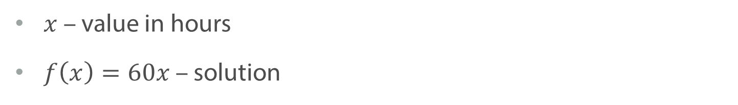
How to convert hours to minutes?
$x$ – value in hours
$f\left(x\right)=60x$ – solution
http://lisajonesstudio.bigcartel.com/product/cat-s-whisker-clock

Slide 9
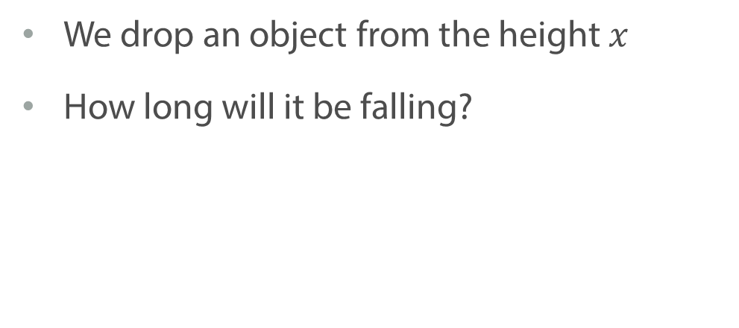
How fast will an object reach ground?
We drop an object from the height $x$
How long will it be falling?

Slide 10
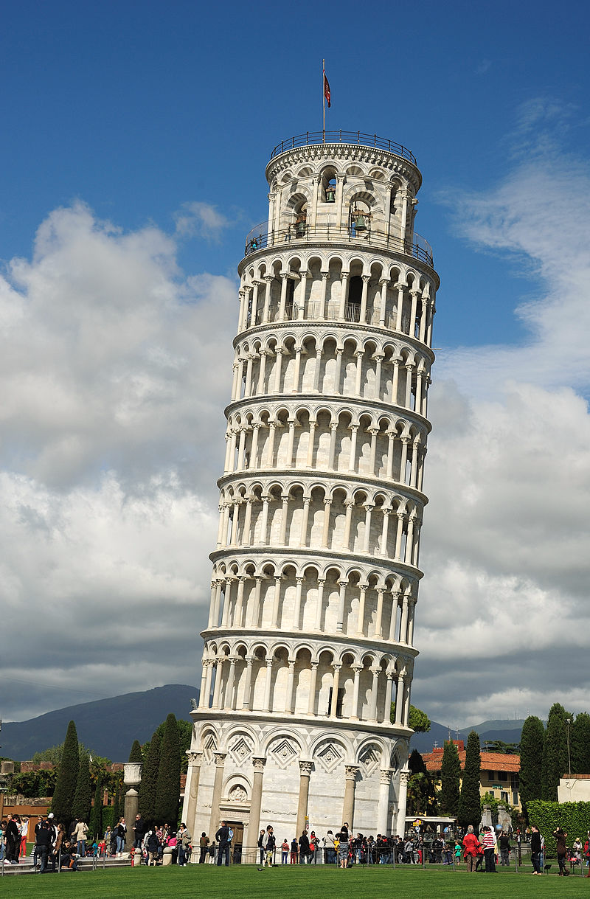
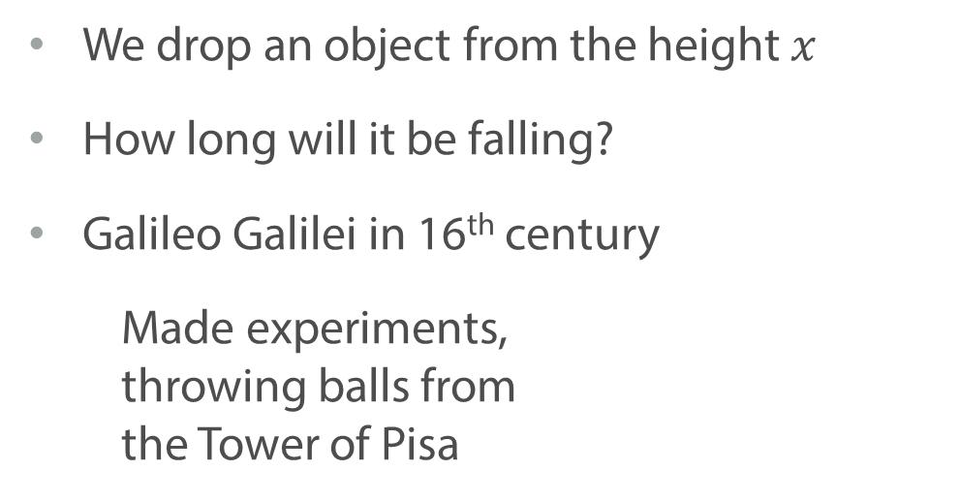
How fast will an object reach ground?
We drop an object from the height $x$
How long will it be falling?
Galileo Galilei in 16th century
Made experiments, throwing balls from the Tower of Pisa
en.wikipedia.org

Slide 11
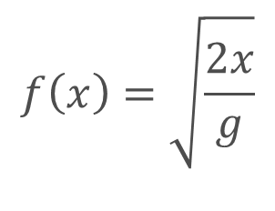
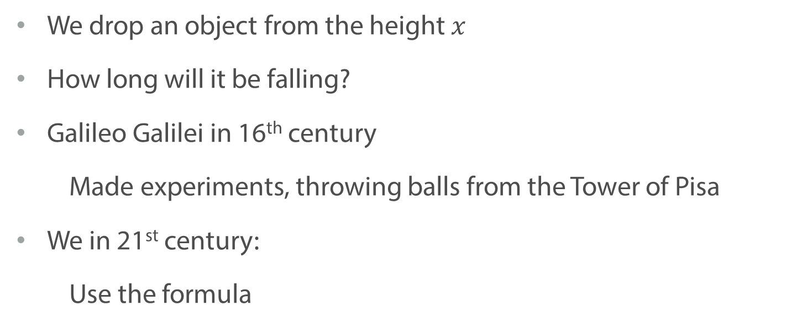
How fast will an object reach ground?
We drop an object from the height $x$
How long will it be falling?
Galileo Galilei in 16th century
Made experiments, throwing balls from the Tower of Pisa
We in 21st century:
Use the formula
$$f\left(x\right)=\sqrt{\frac{2x}{g}}$$

Slide 12
Who is on the picture?
How do you know the answer?
Any formulas?
https://www.fiverr.com/sufyanted/ machine-learning-python-projects-and-build-android-api

Slide 13

Which sentiment the text has?
Which review is positive?
“I like this tool, because it is better than nothing.”
“I don’t dislike this tool.”
“I love this tool as much as myself!”
arxiv.org
Notes:
Classification and interpretation of emotions given a text data is important task for processing customer reviews.

Slide 14
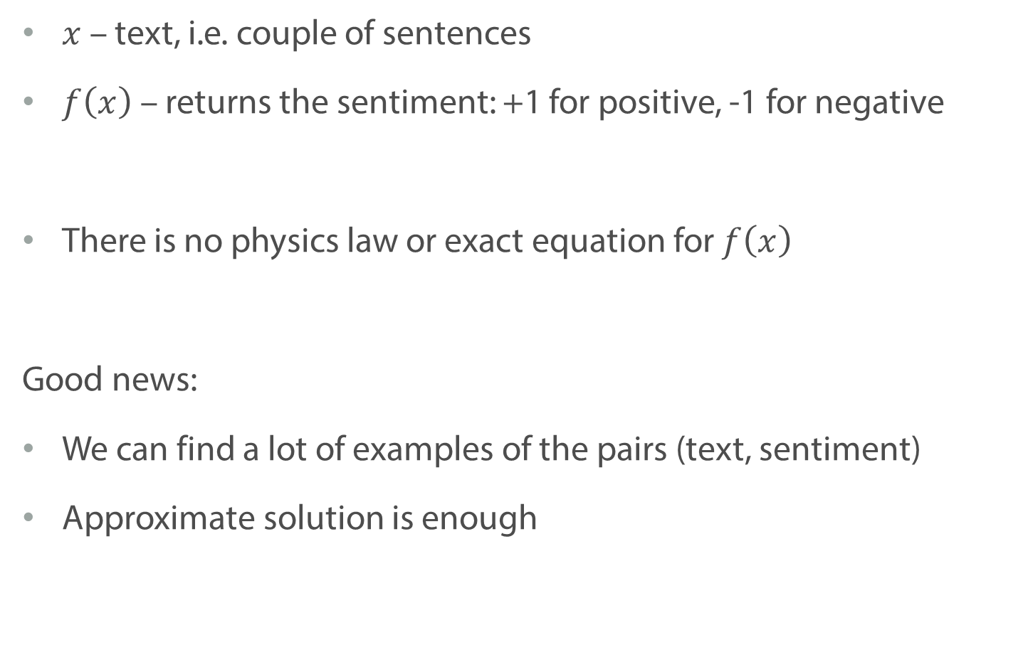
Which sentiment the text has?
$x$ – text, i.e. couple of sentences
$f\left(x\right)$ – returns the sentiment: +1 for positive, -1 for negative
There is no physics law or exact equation for $f\left(x\right)$
Good news:
We can find a lot of examples of the pairs (text, sentiment)
Approximate solution is enough

Slide 15
What is Machine Learning?
Traditional programming
Data
Computer
Output
Algorithm

Slide 16
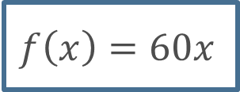

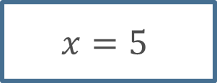
What is Machine Learning?
Traditional programming: convert hours to minutes
$$x=5$$
Computer
$$300$$
$$f\left(x\right)=60x$$

Slide 17
What is Machine Learning?
Traditional programming
Data
Computer
Output
Algorithm
Machine Learning
Data
Computer
Algorithm
Output

Slide 18
What is Machine Learning?
Traditional programming
Data
Computer
Output
Algorithm
Machine Learning: distinguish cats from dogs
Pictures
Computer
Algorithm
Labels

Slide 19
Machine Learning is Everywhere
What user will like based on his/her history and preferences
Which advertisement is relevant for this user at this moment of time
What should be an answer for a specific question/query
What should be the next action based on the route, camera data, etc.
netflix.com / spotify.com / Ads.google.com / dribbble.com / waymo.com / logodesignlove.com

Slide 20
Summary
Machine learning is used in many spheres
We want to infer algorithm from the data, without knowing the exact law or formula
Approximate solution is enough
How rough the solution may be depends on a specific task

Slide 21
Basic Definitions
Notes:
Let us now become more formal. In this video I will try to give you a general understanding on how we define and train machine learning models.

Slide 22
Running Example
We are given the list of apartments and its properties
We would like to obtain an algorithm to predict the price
Examples from Kaggle.com:
Zillow’s Home Value Prediction ($25’000 1st place prize)
Sberbank Russian Housing Market ($12’000 1st place prize)
kaggle.com
Notes:
We will discuss the most basic definitions and illustrate them on one specific example, that we’ll be then using throughout the course.
EXAMPLE:
Consider the following task: you want to define the price of an apartment based on its description. This is a regression task, since we are willing to predict price, which is a real number.

Slide 23
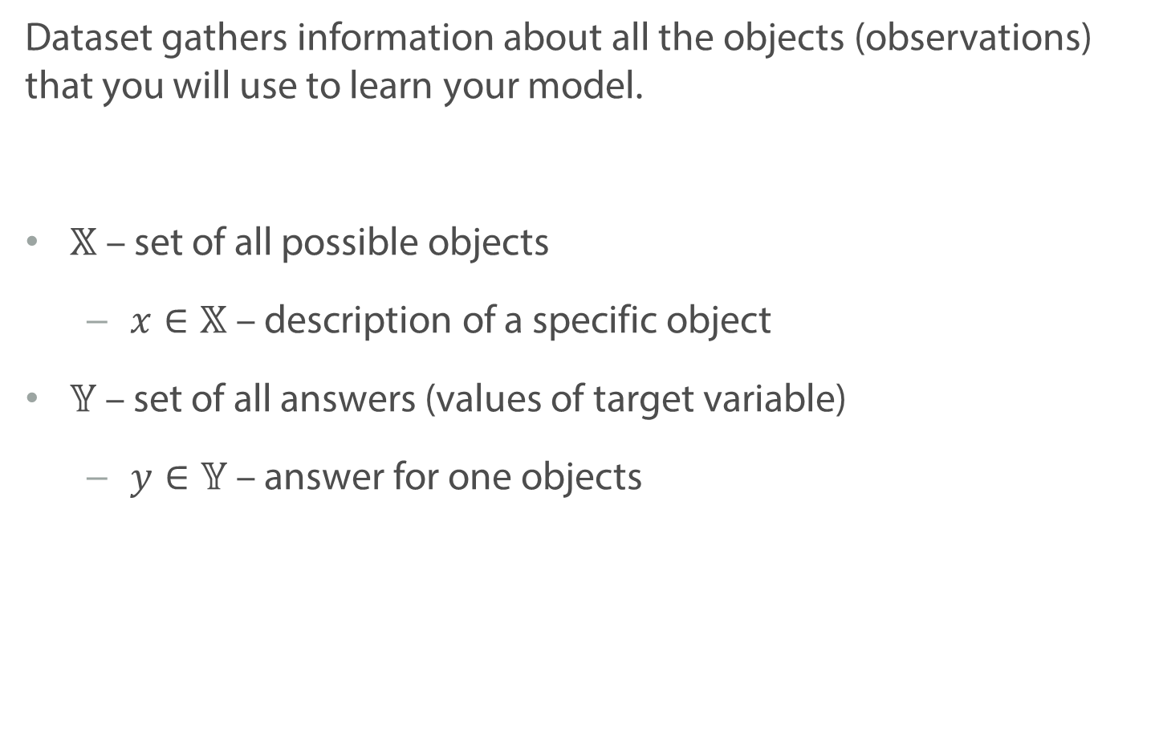
Definition: Dataset
Dataset gathers information about all the objects (observations) that you will use to learn your model.
$𝕏$ – set of all possible objects
$x∈𝕏$ – description of a specific object
$𝕐$ – set of all answers (values of target variable)
$y∈𝕐$ – answer for one objects
Notes:
blackboard bold X

Slide 24
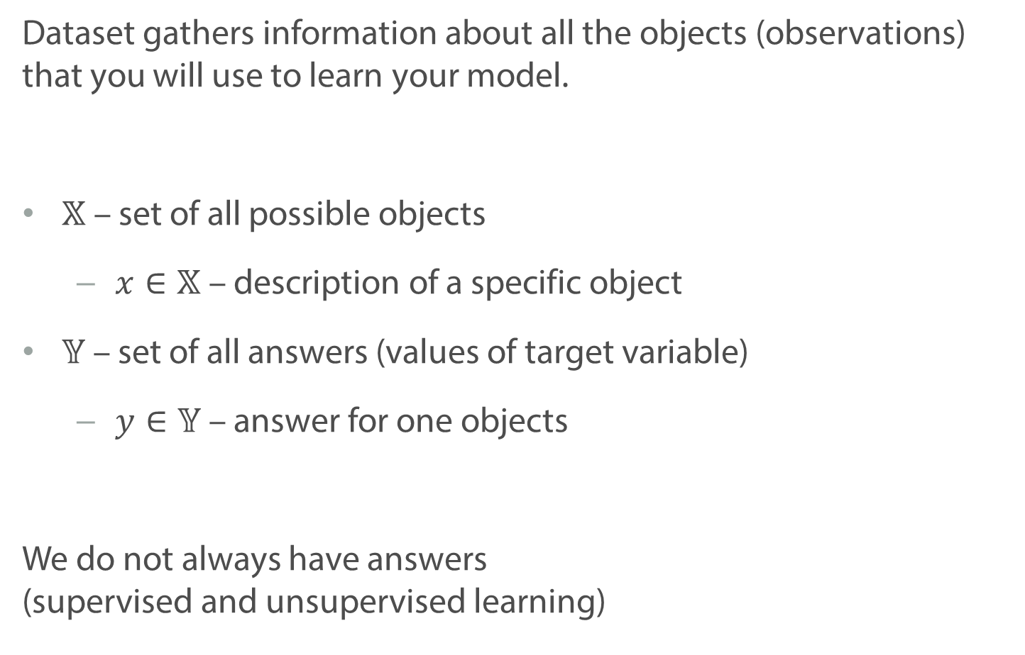
Definition: Dataset
Dataset gathers information about all the objects (observations) that you will use to learn your model.
$𝕏$ – set of all possible objects
$x∈𝕏$ – description of a specific object
$𝕐$ – set of all answers (values of target variable)
$y∈𝕐$ – answer for one objects
We do not always have answers (supervised and unsupervised learning)

Slide 25
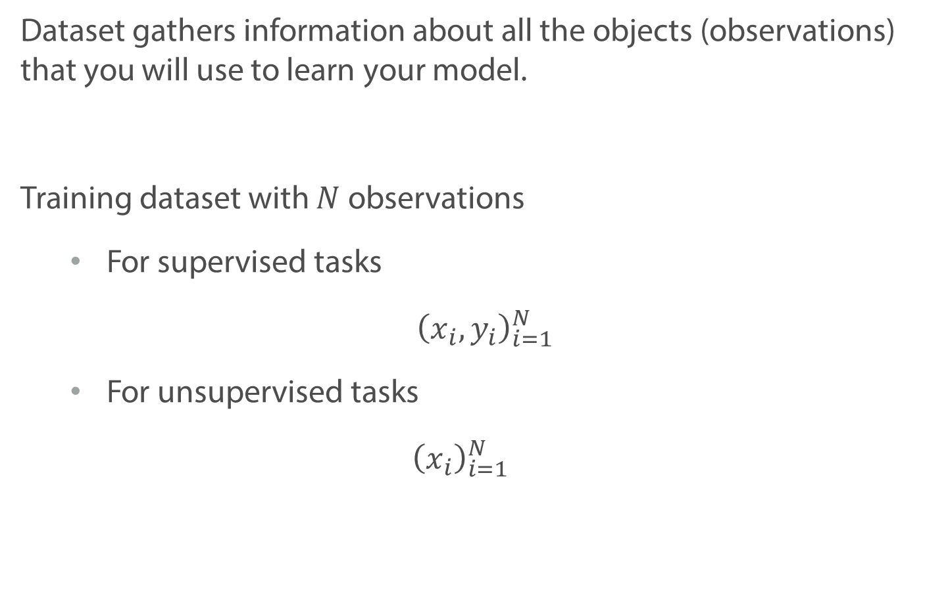
Definition: Dataset
Dataset gathers information about all the objects (observations) that you will use to learn your model.
Training dataset with $N$ observations
For supervised tasks
$${\left(x_{i}, y_{i}\right)}_{i=1}^{N}$$
For unsupervised tasks
$${\left(x_{i}\right)}_{i=1}^{N}$$

Slide 26
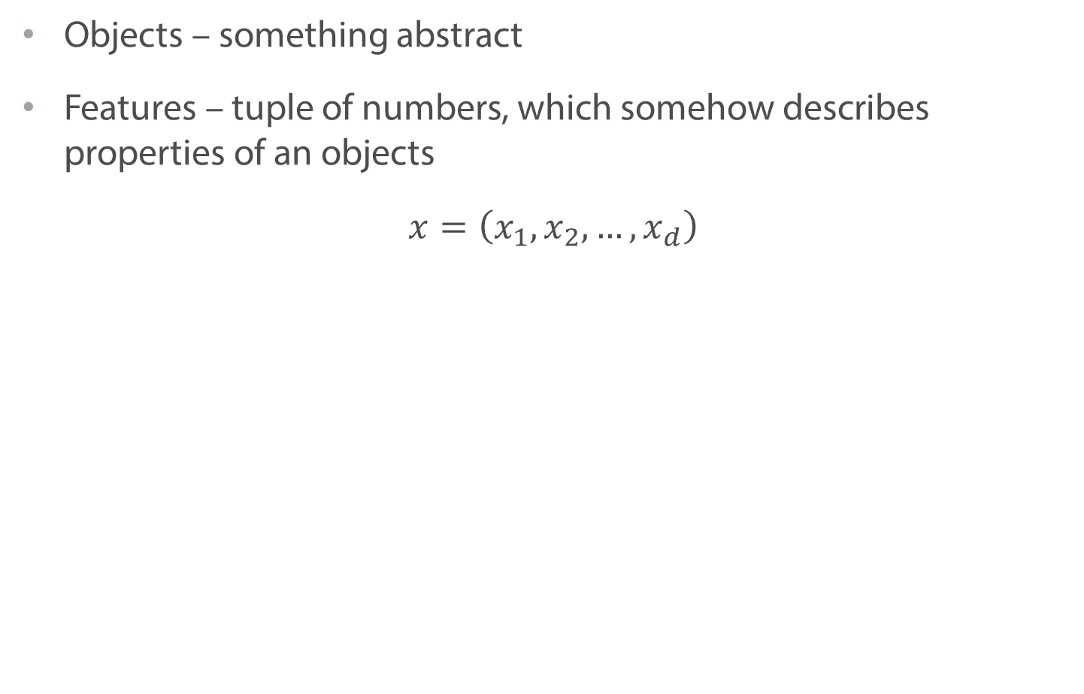
Definition: Features
Objects – something abstract
Features – tuple of numbers, which somehow describes properties of an objects
$$x=\left(x_{1},x_{2}, …, x_{d}\right)$$

Slide 27
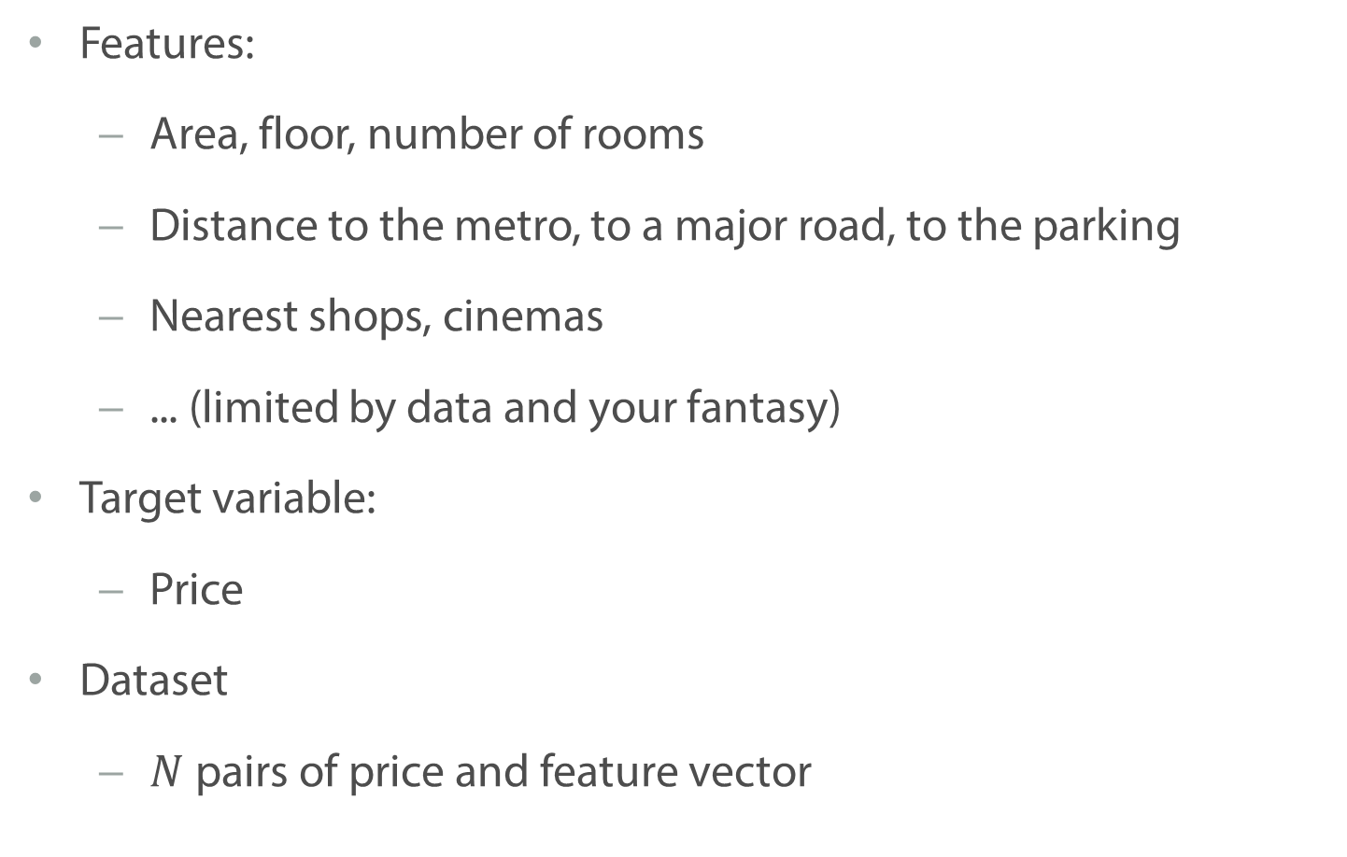
Example
Features:
Area, floor, number of rooms
Distance to the metro, to a major road, to the parking
Nearest shops, cinemas
... (limited by data and your fantasy)
Target variable:
Price
Dataset
$N$pairs of price and feature vector
kaggle.com

Slide 28
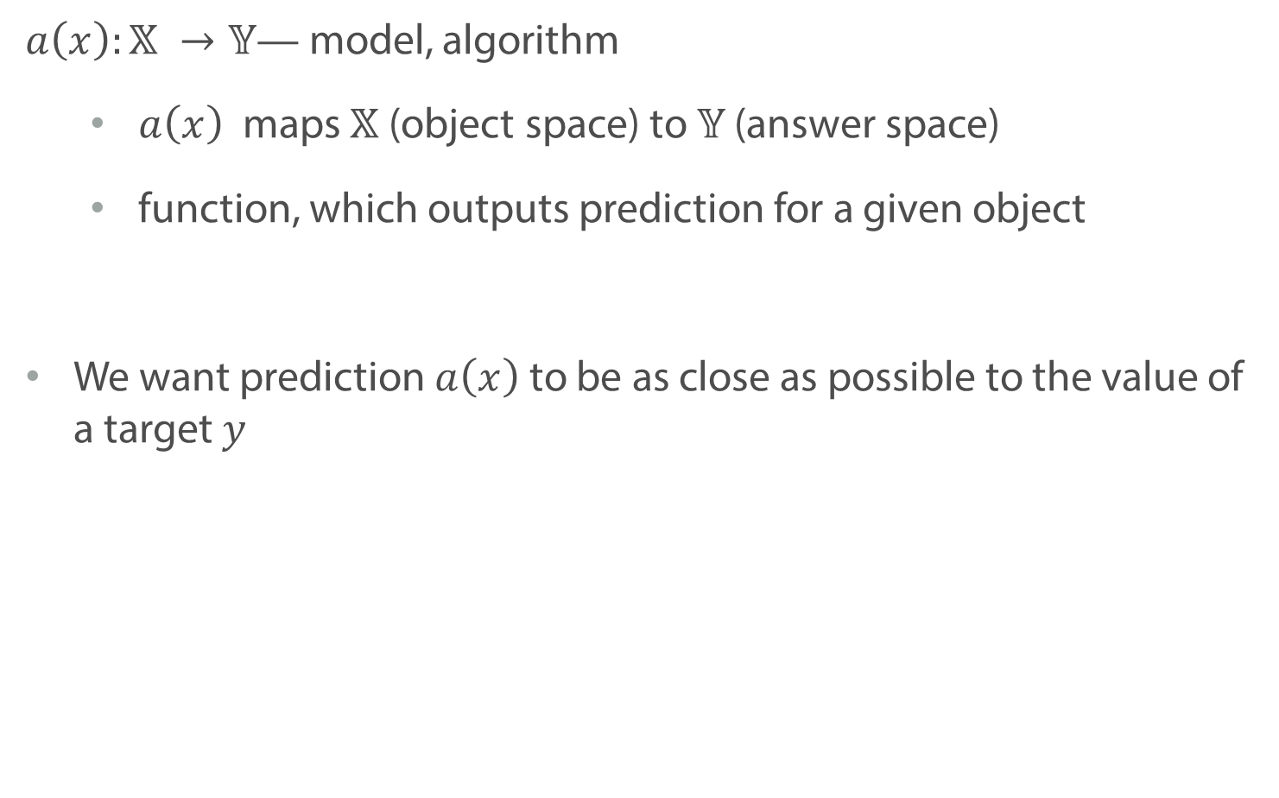
Definition: Model
$a\left(x\right):𝕏 →𝕐$— model, algorithm
$a\left(x\right)$ maps $𝕏$ (object space) to $𝕐$ (answer space)
function, which outputs prediction for a given object
We want prediction $a\left(x\right)$ to be as close as possible to the value of a target $y$

Slide 29
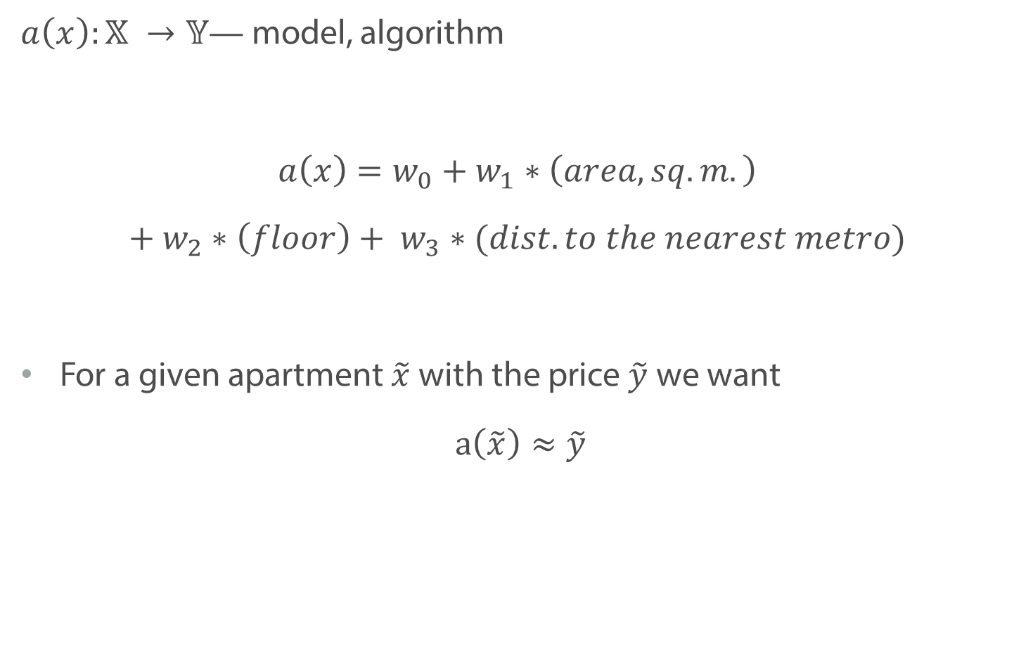
Example
$a\left(x\right):𝕏 →𝕐$— model, algorithm
$$a\left(x\right)=w_{0}+w_{1}∗\left(area, sq.m.\right)$$
$$+ w_{2}∗\left(floor\right)+ w_{3}∗(dist. to the nearest metro)$$
For a given apartment $\tilde{x}$ with the price $\tilde{y}$ we want
$a\left(\tilde{x}\right)≈\tilde{y}$

Slide 30
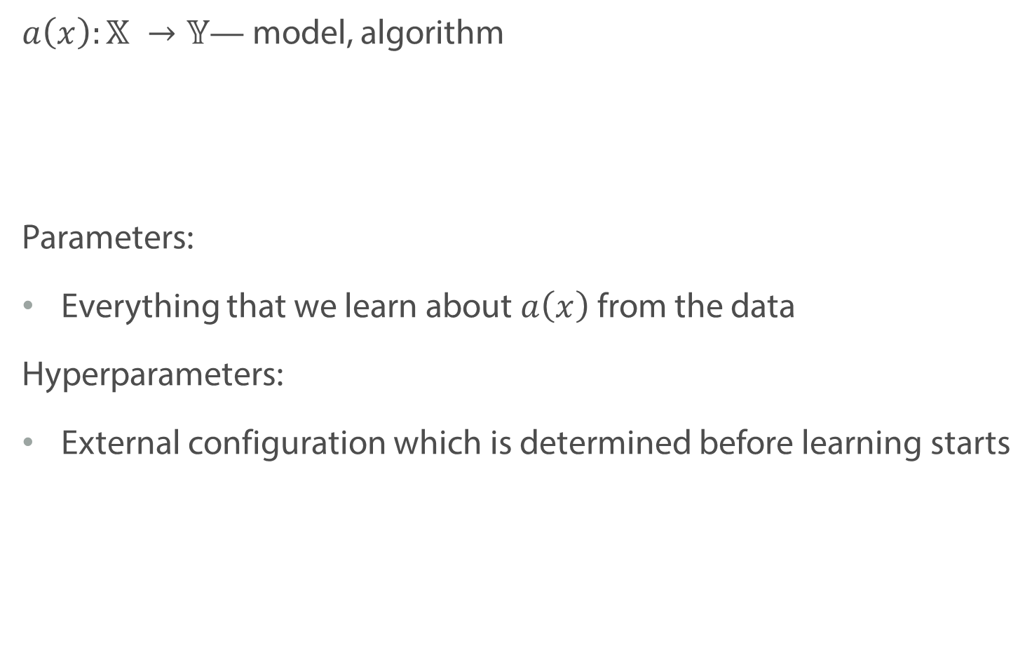
Definition: Parameters and Hyperparameters
$a\left(x\right):𝕏 →𝕐$— model, algorithm
Parameters:
Everything that we learn about $a\left(x\right)$ from the data
Hyperparameters:
External configuration which is determined before learning starts

Slide 31
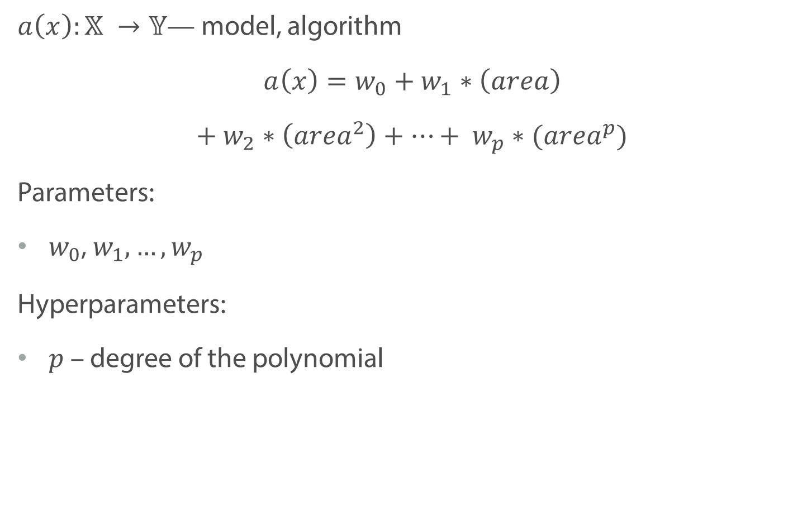
Example: Parameters and Hyperparameters
$a\left(x\right):𝕏 →𝕐$— model, algorithm
$$a\left(x\right)=w_{0}+w_{1}∗\left(area\right)$$
$$+ w_{2}∗\left(area^{2}\right)+…+ w_{p}∗(area^{p})$$
Parameters:
$w_{0}$, $w_{1},…,w_{p}$
Hyperparameters:
$p$ – degree of the polynomial

Slide 32
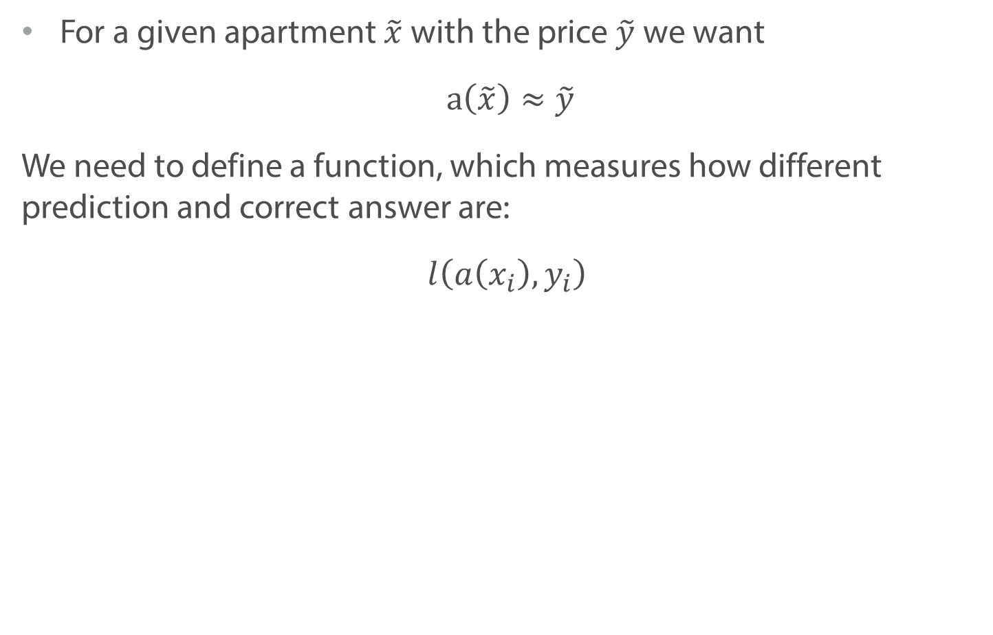
Definition: Loss Function
For a given apartment $\tilde{x}$ with the price $\tilde{y}$ we want
$a\left(\tilde{x}\right)≈\tilde{y}$
We need to define a function, which measures how different prediction and correct answer are:
$$l\left(a\left(x_{i}\right),y_{i}\right)$$

Slide 33
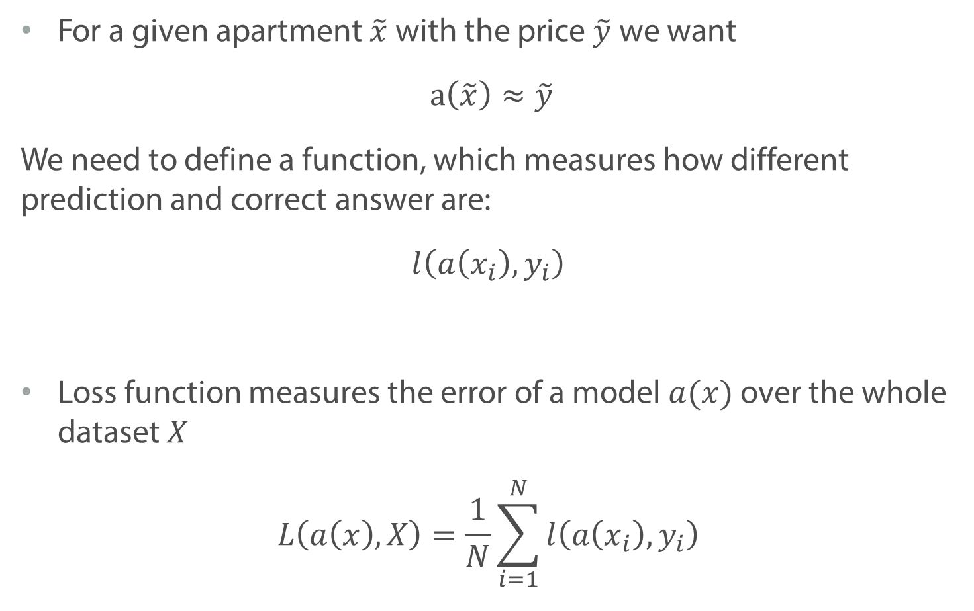
Definition: Loss function
For a given apartment $\tilde{x}$ with the price $\tilde{y}$ we want
$a\left(\tilde{x}\right)≈\tilde{y}$
We need to define a function, which measures how different prediction and correct answer are:
$$l\left(a\left(x_{i}\right),y_{i}\right)$$
Loss function measures the error of a model $a(x)$ over the whole dataset $X$
$$L\left(a\left(x\right), X\right)=\frac{1}{N}\sum_{i=1}^{N}{l\left(a\left(x_{i}\right),y_{i}\right)}$$

Slide 34
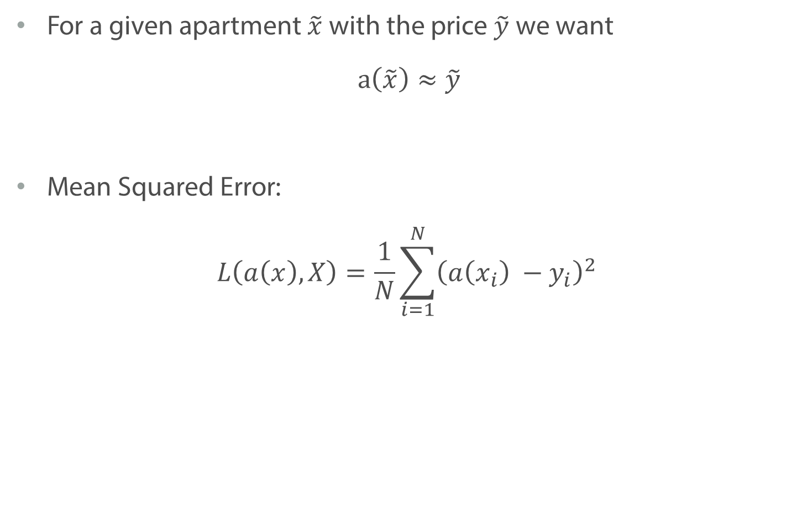
Example: Loss function
For a given apartment $\tilde{x}$ with the price $\tilde{y}$ we want
$a\left(\tilde{x}\right)≈\tilde{y}$
Mean Squared Error:
$$L\left(a\left(x\right), X\right)=\frac{1}{N}\sum_{i=1}^{N}{{\left(a\left(x_{i}\right) −y_{i}\right)}^{2}}$$

Slide 35
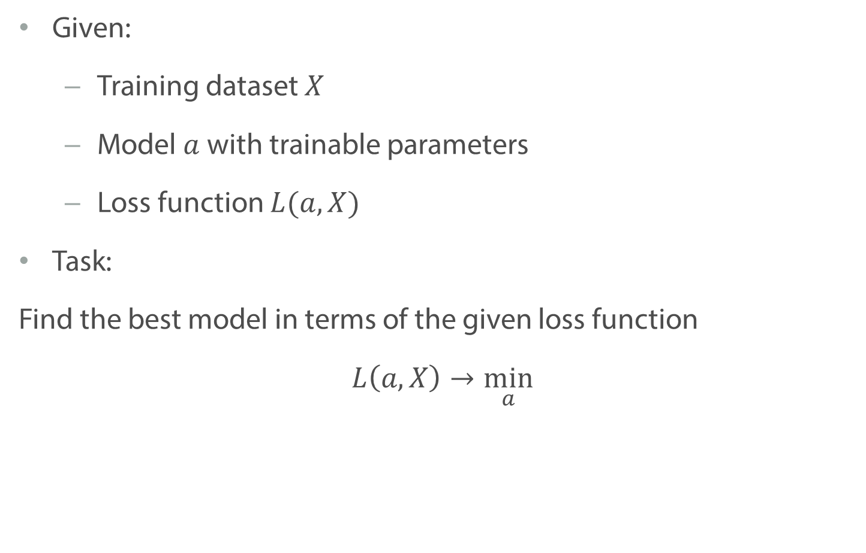
Training the model
Given:
Training dataset $X$
Model $a$ with trainable parameters
Loss function $L(a, X)$
Task:
Find the best model in terms of the given loss function
$$L\left(a, X\right)\underset{ a}{→min}$$

Slide 36
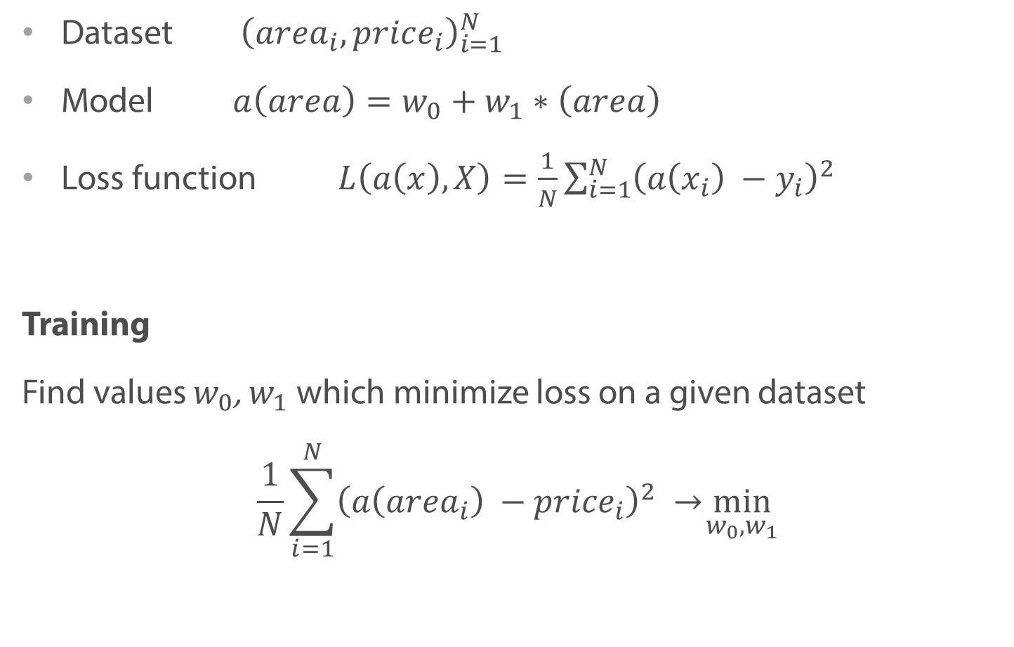
Example: Training the model
Dataset ${\left(area_{i}, price_{i}\right)}_{i=1}^{N}$
Model $a\left(area\right)=w_{0}+w_{1}∗\left(area\right)$
Loss function $L\left(a\left(x\right), X\right)=\frac{1}{N}\sum_{i=1}^{N}{{\left(a\left(x_{i}\right) −y_{i}\right)}^{2}}$
Training
Find values $w_{0}$, $w_{1}$ which minimize loss on a given dataset
$$\frac{1}{N}\sum_{i=1}^{N}{{\left(a\left({area}_{i}\right) −{price}_{i}\right)}^{2}}\underset{ w_{0}, w_{1}}{→min}$$

Slide 37
Definition: Metric
Used to evaluate performance of the model after training
Calculated on the “unseen” (test) data
May coincide with loss function

Slide 38
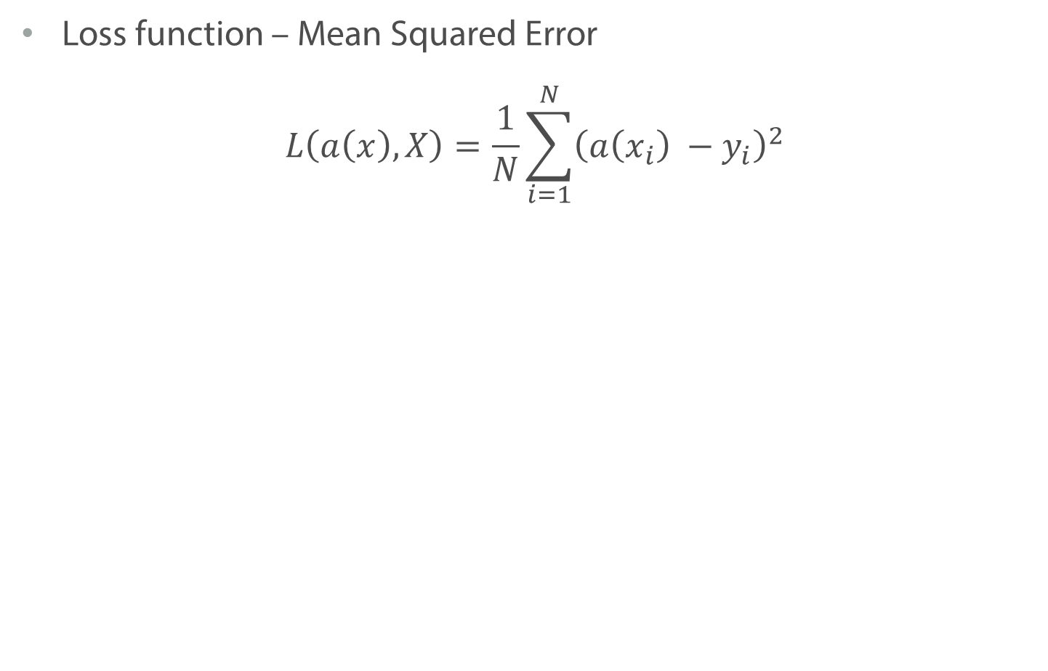
Example: Metric and Loss Function
Loss function – Mean Squared Error
$$L\left(a\left(x\right), X\right)=\frac{1}{N}\sum_{i=1}^{N}{{\left(a\left(x_{i}\right) −y_{i}\right)}^{2}}$$

Slide 39
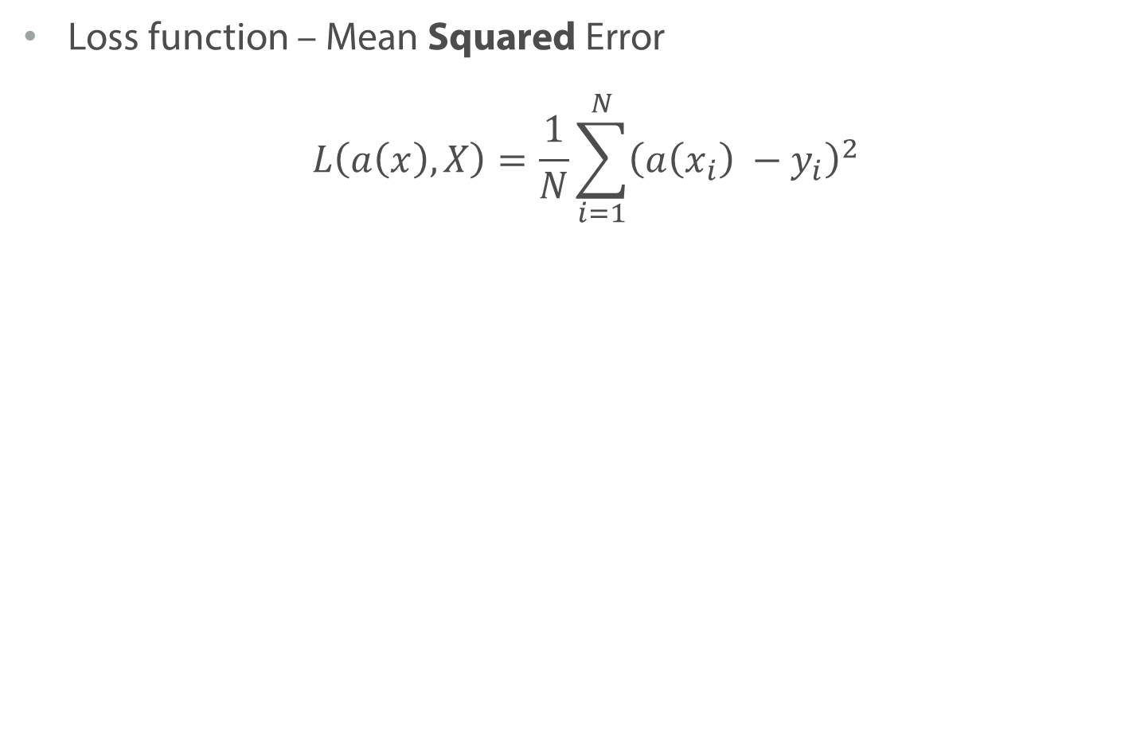
Example: Metric and Loss Function
Loss function – Mean Squared Error
$$L\left(a\left(x\right), X\right)=\frac{1}{N}\sum_{i=1}^{N}{{\left(a\left(x_{i}\right) −y_{i}\right)}^{2}}$$

Slide 40
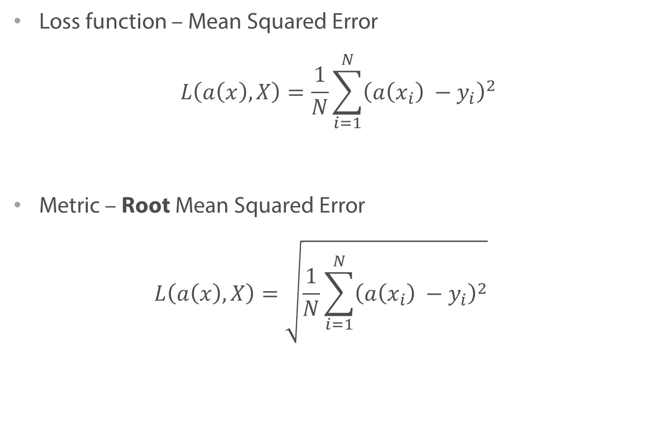
Example: Metric and Loss Function
Loss function – Mean Squared Error
$$L\left(a\left(x\right), X\right)=\frac{1}{N}\sum_{i=1}^{N}{{\left(a\left(x_{i}\right) −y_{i}\right)}^{2}}$$
Metric – Root Mean Squared Error
$$L\left(a\left(x\right), X\right)=\sqrt{\frac{1}{N}\sum_{i=1}^{N}{{\left(a\left(x_{i}\right) −y_{i}\right)}^{2}}}$$

Slide 41
ML Pipeline
Model
Train the model
Loss Function
Train Data
Test Data

Slide 42
ML Pipeline
Model
Train the model
Loss Function
Train Data
Model with optimal parameters
Test Data

Slide 43
ML Pipeline
Model
Train the model
Loss Function
Train Data
Model with optimal parameters
Test Data
Test model
Metric Function

Slide 44
ML Pipeline
Model
Train the model
Loss Function
Train Data
Model with optimal parameters
Test Data
Test model
Metric Function
Model Performance

Slide 45
Summary
Dataset gathers information about objects and answers for them
Model predicts answer for a given object
Loss function calculates how wrong the model is. It is used to find optimal parameters on the training data
Metric is similar to loss function (or exactly the same), but is used to evaluate how model performs on test data

Slide 46
ML Problems

Slide 47
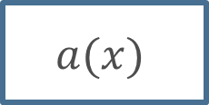


Supervised and Unsupervised learning
Supervised learning
For each object in your data you have correct answer
$$x$$
Computer
$$a(x)$$
$$y$$

Slide 48
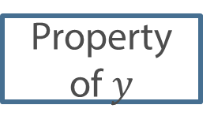

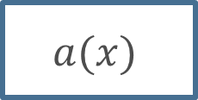
Supervised and Unsupervised learning
Supervised learning
For each object in your data you have correct answer
Unsupervised learning
You observe only objects and want to find some patterns in them
$$x$$
Computer
$$a(x)$$
$$y$$
$$x$$
Computer
$$a(x)$$
Property of$y$

Slide 49
Supervised learning
Regression
Classification
Ranking
etc.
Notes:
Structured prediction

Slide 50
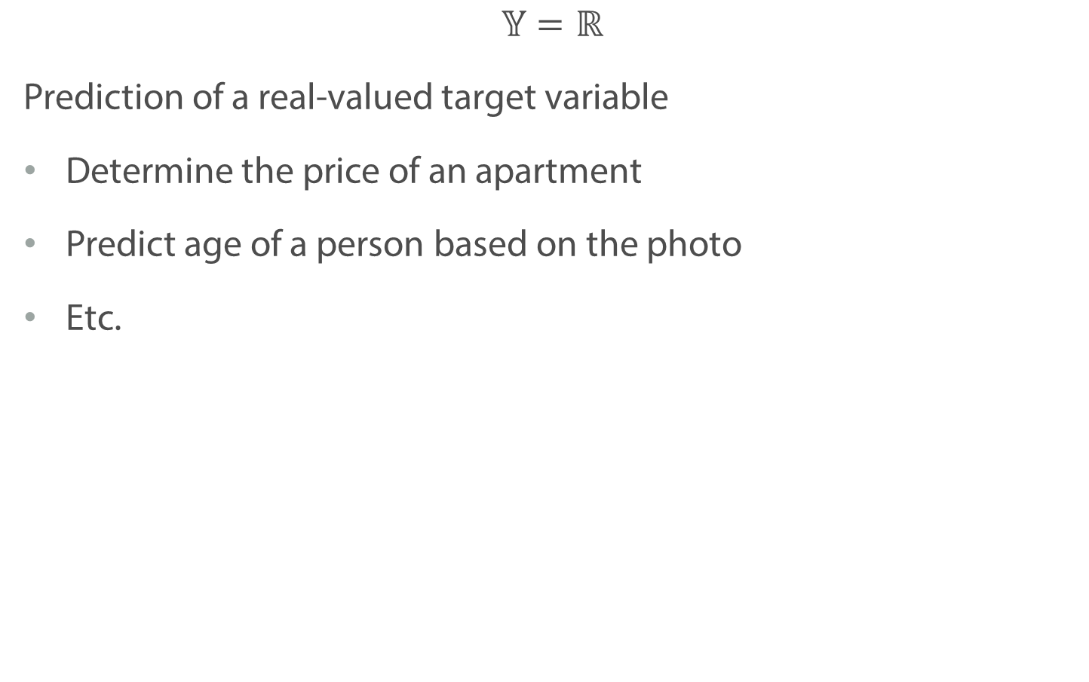
Regression tasks
$$𝕐=ℝ$$
Prediction of a real-valued target variable
Determine the price of an apartment
Predict age of a person based on the photo
Etc.
http://pgfplots.net/tikz/examples/regression-line/

Slide 51
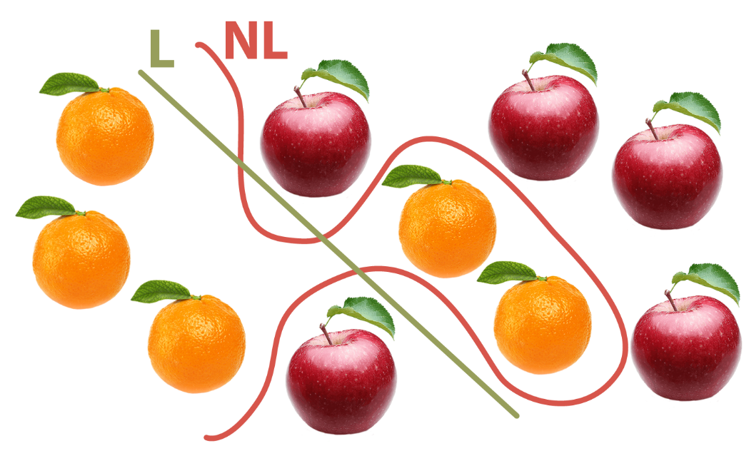
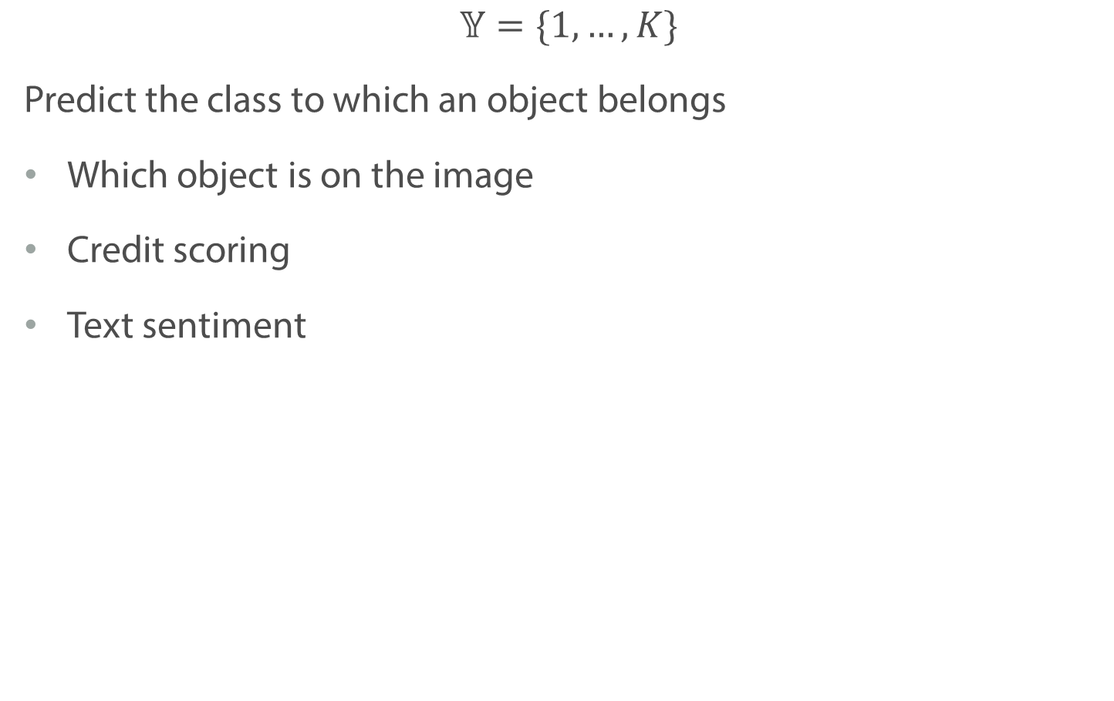
Classification tasks
$𝕐=\{1, …, K\}$
Predict the class to which an object belongs
Which object is on the image
Credit scoring
Text sentiment

Slide 52
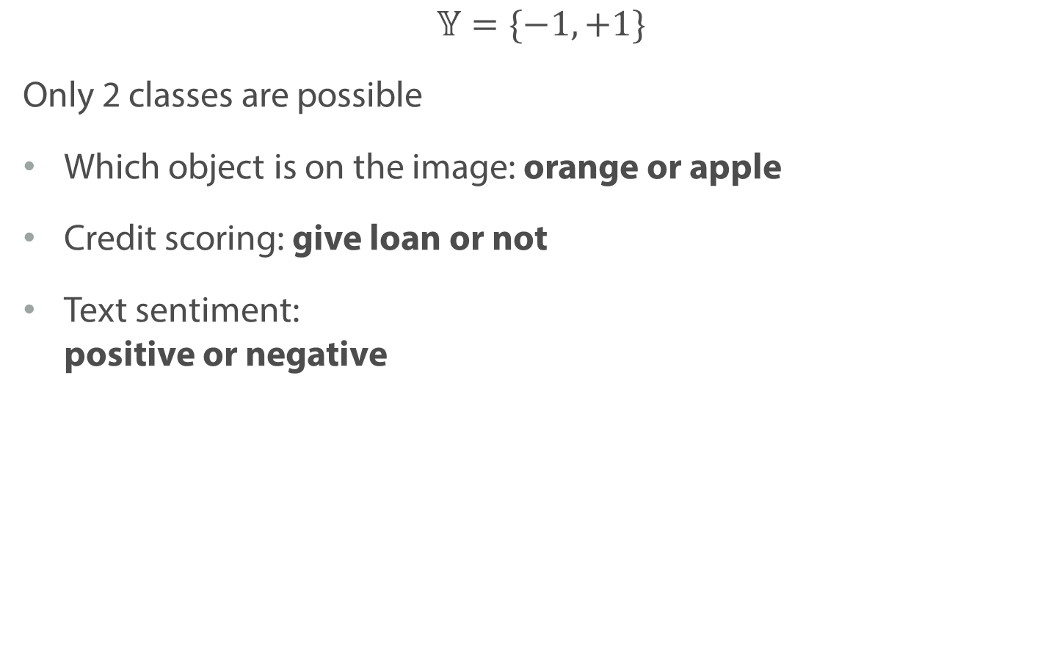
Classification tasks: binary
$𝕐=\{−1,+1\}$
Only 2 classes are possible
Which object is on the image: orange or apple
Credit scoring: give loan or not
Text sentiment: positive or negative

Slide 53
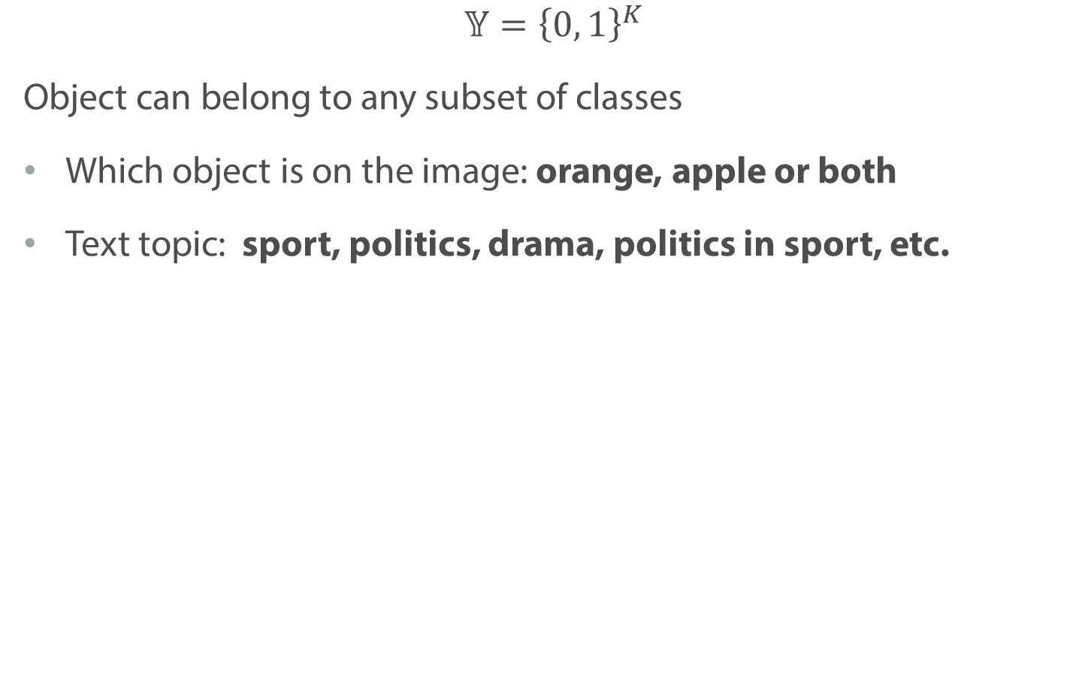
Classification tasks: Intersecting classes
$$𝕐={\left\{0, 1\right\}}^{K}$$
Object can belong to any subset of classes
Which object is on the image: orange, apple or both
Text topic: sport, politics, drama, politics in sport, etc.

Slide 54
Unsupervised learning
Clustering
Metrics learning and Dimensionality reduction
Etc.

Slide 55

Clustering
Given several objects
We want to split then into $K$ clusters
Objects within each cluster should be similar
scikit-learn.org

Slide 56
Metrics Learning and Dimensionality Reduction
Given high-dimensional or complex objects (Text, Image)
Describe each object with numeric vector, so that similar objects are described by the similar vectors
scikit-learn.org / arxiv.org

Slide 57
Summary
In supervised learning we know correct answers for each object
Regression, classification
In unsupervised learning we have objects only
Clustering, metrics learning
There are other task formulations

Slide 58
Feature Types

Slide 59
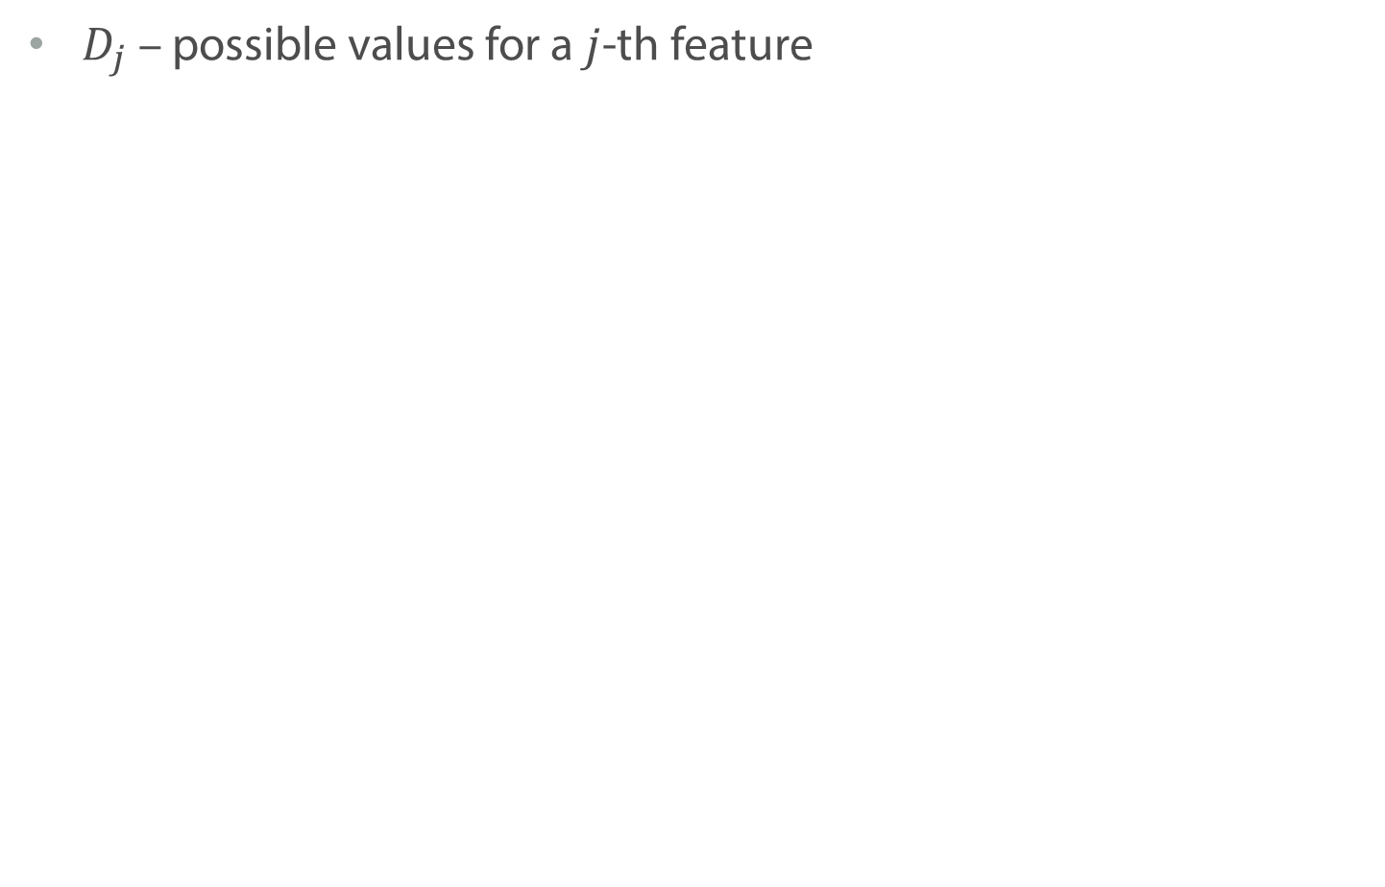
Feature Types
$D_{j}$ – possible values for a $j$-th feature

Slide 60
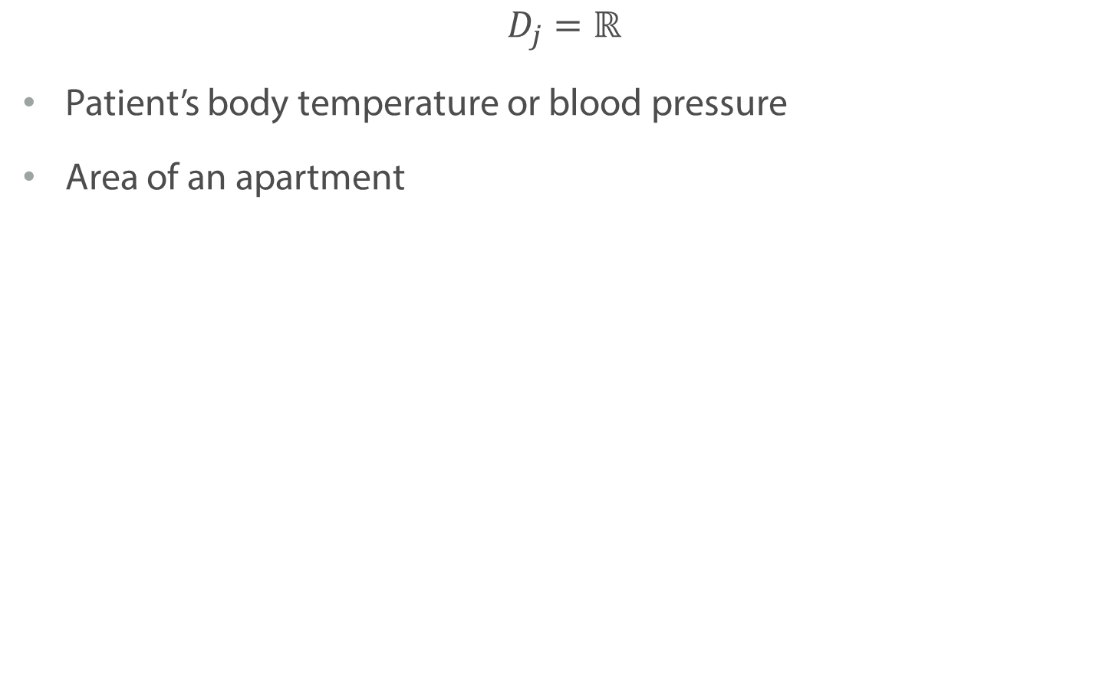
Numerical Features
$$D_{j}=ℝ$$
Patient’s body temperature or blood pressure
Area of an apartment

Slide 61
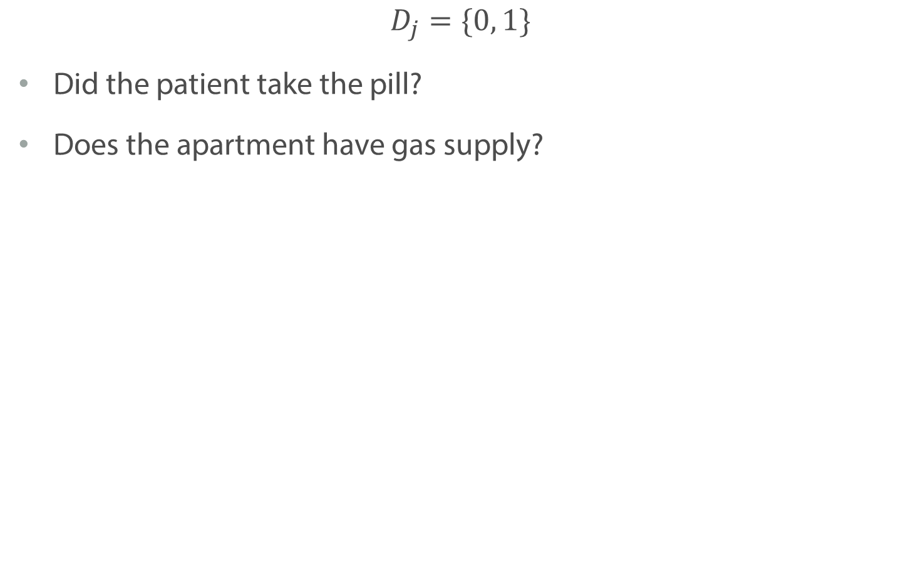
Binary Features
$$D_{j}=\{0, 1\}$$
Did the patient take the pill?
Does the apartment have gas supply?

Slide 62
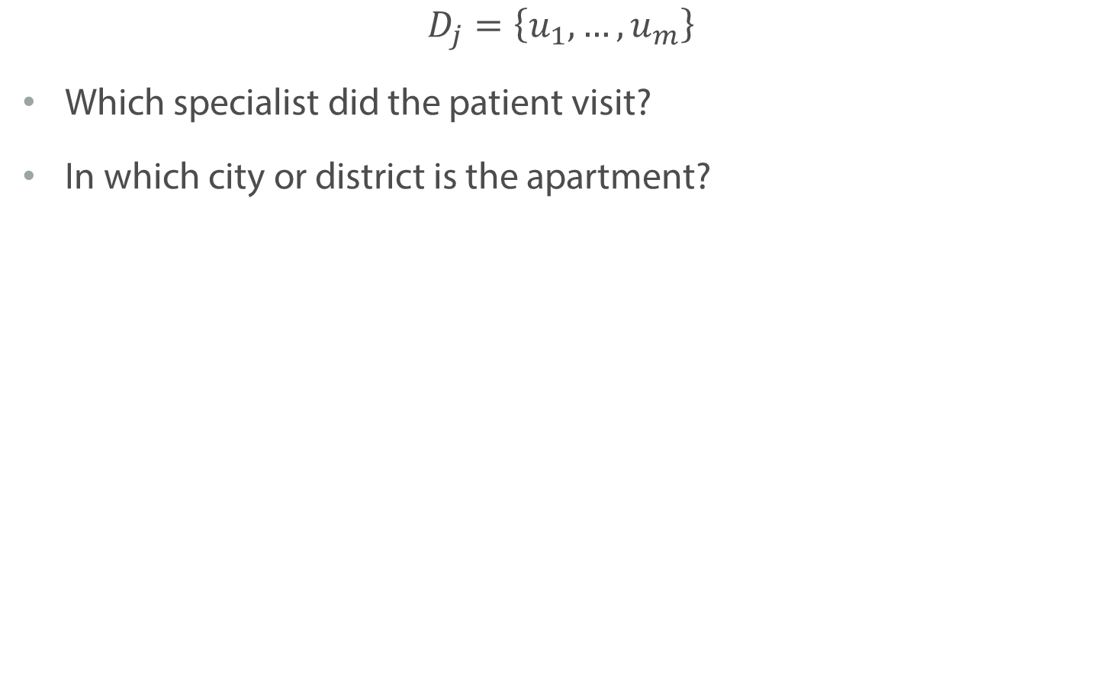
Categorical Features
$$D_{j}=\left\{u_{1},…, u_{m}\right\}$$
Which specialist did the patient visit?
In which city or district is the apartment?

Slide 63
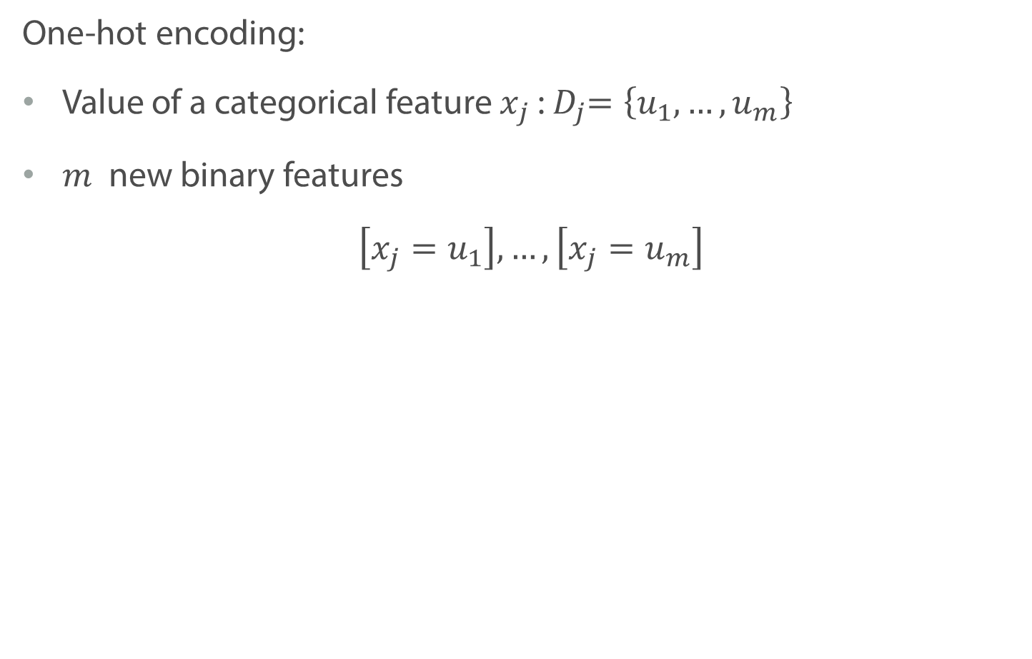
Encoding Categorical Features: OHE
One-hot encoding:
Value of a categorical feature $x_{j}$:${ D}_{j}=\left\{u_{1},…, u_{m}\right\}$
$m$ new binary features
$\left[x_{j}=u_{1}\right], …, \left[x_{j}=u_{m}\right]$

Slide 64
Encoding Categorical Features: OHE
One-hot encoding:
Value of a categorical feature $x_{j}$:${ D}_{j}=\left\{u_{1},…, u_{m}\right\}$
$m$ new binary features
$\left[x_{j}=u_{1}\right], …, \left[x_{j}=u_{m}\right]$
District
Central
South
Central
North
South
South
Central | South | North
1 | 0 | 0
0 | 1 | 0
1 | 0 | 0
0 | 0 | 1
0 | 1 | 0
0 | 1 | -

Slide 65
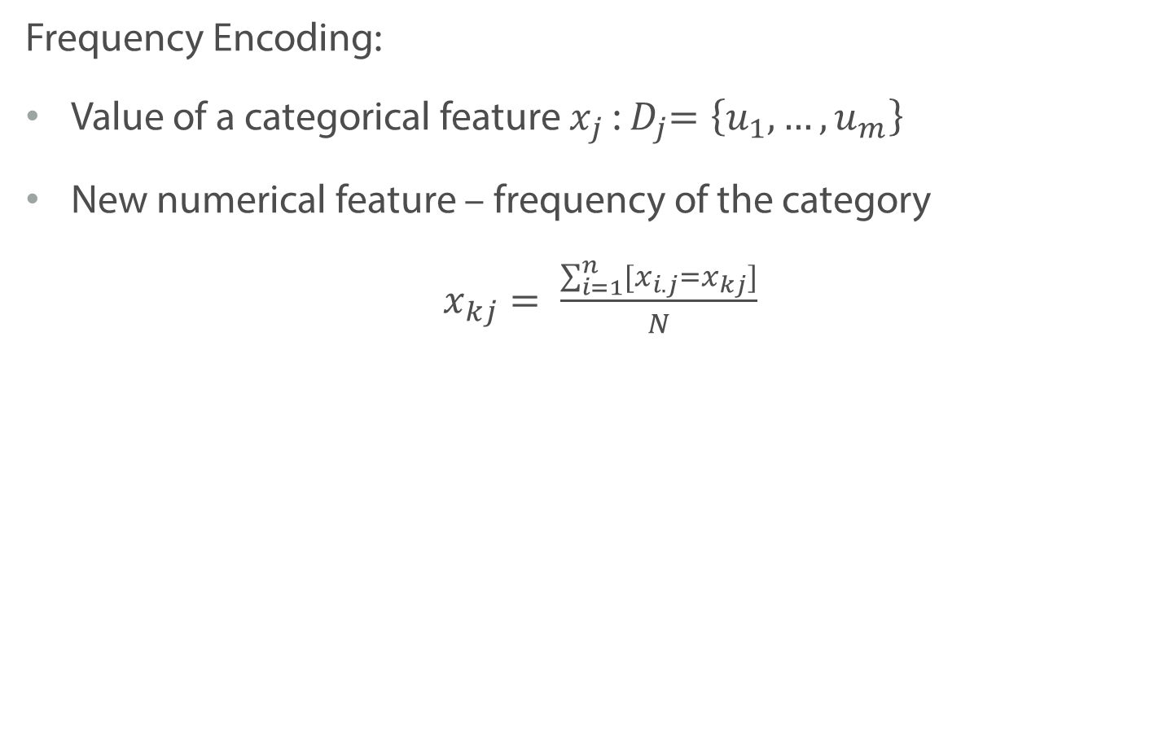
Encoding Categorical Features: Frequency
Frequency Encoding:
Value of a categorical feature $x_{j}$:${ D}_{j}=\left\{u_{1},…, u_{m}\right\}$
New numerical feature – frequency of the category
$x_{kj}= \frac{\sum_{i=1}^{n}{[x_{i.j}=x_{kj}]}}{N}$

Slide 66
Encoding Categorical Features: Frequency
Frequency Encoding:
Value of a categorical feature $x_{j}$:${ D}_{j}=\left\{u_{1},…, u_{m}\right\}$
New numerical feature – frequency of the category
$x_{kj}= \frac{\sum_{i=1}^{n}{[x_{i.j}=x_{kj}]}}{N}$
District
Central
South
Central
North
South
South
District
0.33
0.5
0.33
0.17
0.5
0.5

Slide 67
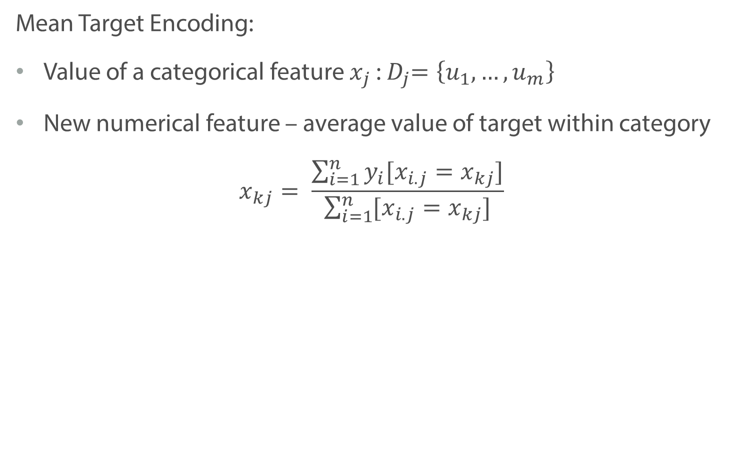
Encoding Categorical Features: Mean
Mean Target Encoding:
Value of a categorical feature $x_{j}$:${ D}_{j}=\left\{u_{1},…, u_{m}\right\}$
New numerical feature – average value of target within category
$$x_{kj}= \frac{\sum_{i=1}^{n}{y_{i}[x_{i.j}=x_{kj}]}}{\sum_{i=1}^{n}{[x_{i.j}=x_{kj}]}}$$

Slide 68
Encoding Categorical Features: Mean
Mean Target Encoding:
Value of a categorical feature $x_{j}$:${ D}_{j}=\left\{u_{1},…, u_{m}\right\}$
New numerical feature – average value of target within category
$$x_{kj}= \frac{\sum_{i=1}^{n}{y_{i}[x_{i.j}=x_{kj}]}}{\sum_{i=1}^{n}{[x_{i.j}=x_{kj}]}}$$
District | Price
Central | 10.000
South | 4.000
Central | 9.000
North | 7.000
South | 5.000
South | 6.000
District
9.500
5.000
9.500
7.000
5.000
5.000

Slide 69
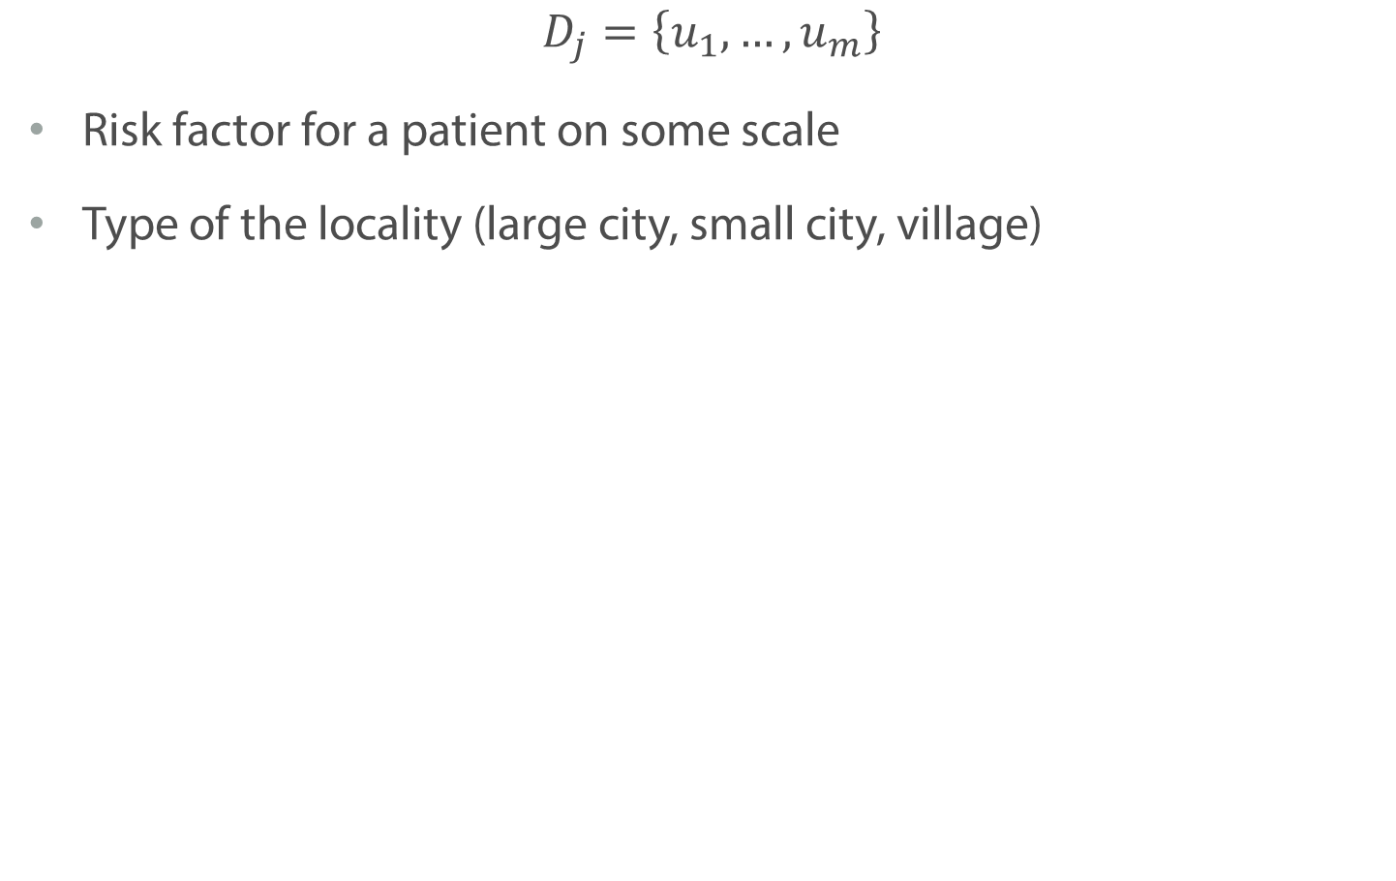
Ordinal Features
$$D_{j}=\left\{u_{1},…, u_{m}\right\}$$
Risk factor for a patient on some scale
Type of the locality (large city, small city, village)

Slide 70
Summary
There are different types of features
We have to carefully work with all of them to save their properties

